Slide 1

Team Name & Logo
STARTUP
PITCH DECK
Present by …
MSOE Hacksgiving 2025

Slide 2
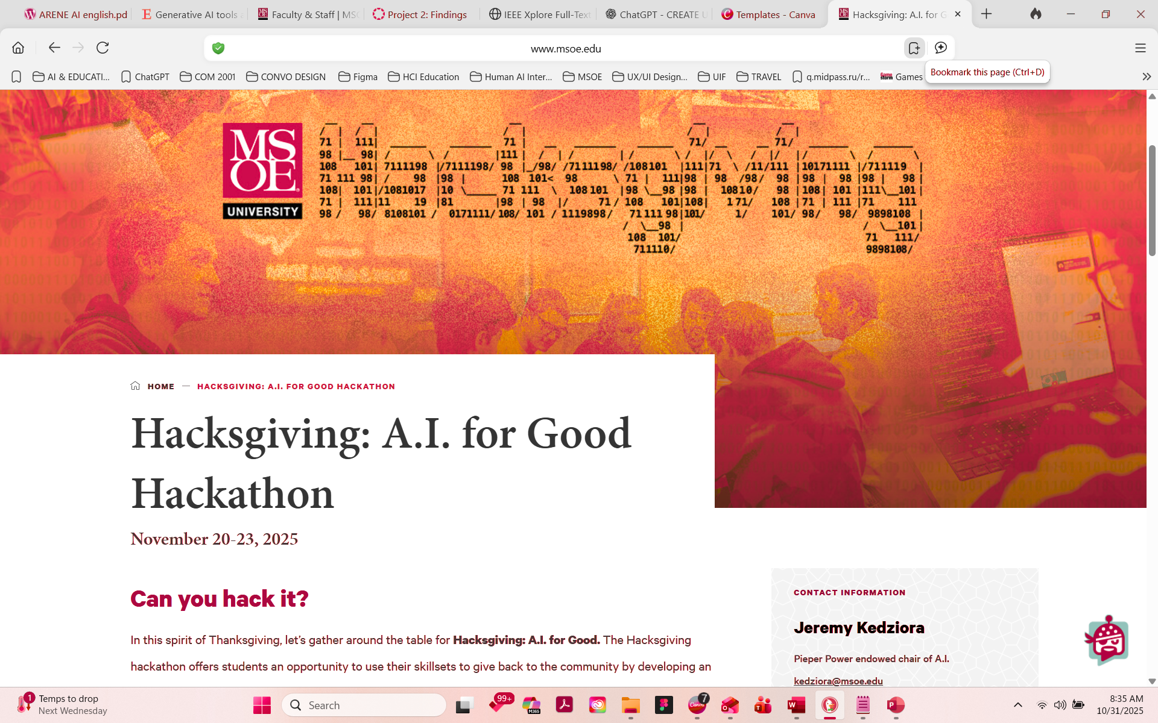

Slide 3





MEET THE TEAM
Thank you for your time! Reach out to us for questions.
Dani Martinez
Harper Russo
Chief Executive Officer
Chief Executive Officer
www.reallygreatsite.com
Morgan Maxwell
Neil Tran
hello@reallygreatsite.com
Chief Executive Officer
Director
123 Anywhere Street., Any City

Slide 4
TODAY'S AGENDA
01
06
INTRODUCTION
TRACTION
02
07
PROBLEM STATEMENT
REVENUE MODEL
03
08
OUR INNOVATIVE SOLUTIONS
ACCOMPLISHMENTS DATE
04
09
SIZE OF MARKET
USE OF FUNDS
05
10
KEY COMPETITIVE ADVANTAGES
MEET THE TEAM

Slide 5
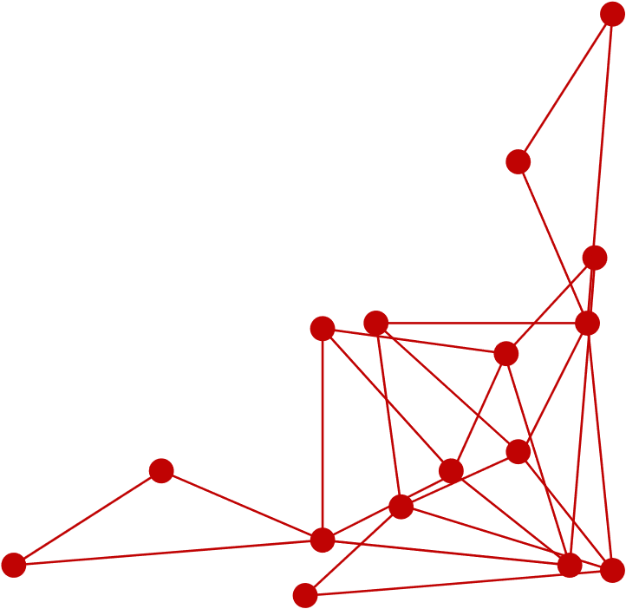


Lack of Brand Differentiation
Startups often find it hard to make their brand unique in a crowded market. Without a clear way to stand out, they struggle to catch the eye of potential customers and lose out to bigger competitors.
Inconsistent Brand Messaging
inconsistency in brand messaging across various marketing channels confuses potential customers and dilutes brand perception. Startups often face challenges in maintaining a cohesive message that effectively communicates their value proposition and resonates with their target audience.
Keeping Up with Trends
The market changes fast, and startups need to keep up. But without a big team or resources, it's tough to stay on top of the latest trends and adapt their marketing strategies accordingly.
PROBLEM STATEMENT

Slide 6


OUR INNOVATIVE SOLUTIONS
Find Unique Selling Point
Brand Messaging Guidelines
Agile Marketing Approach
Help startups figure out what makes them special and build their brand around it. This involves learning about their competitors and target audience, then creating a clear message that sets them apart.
Make sure all of the startup's marketing materials send the same message. This means having clear guidelines for how they talk about themselves and making sure everyone sticks to them.
Help startups adapt quickly to changes in the market. This means keeping an eye on what's happening, analyzing data, and being willing to try new things to keep their marketing strategy fresh and effective.

Slide 7
DISCOVER OUR SERVICES
Brand Building
Digital Marketing
Marketing Analytics
PR Support
We create a strong brand identity, including logos and design elements, to help startups stand out and gain trust.
We create a strong brand identity, including logos and design elements, to help startups stand out and gain trust.
We provide insights and reports on marketing performance to help startups make informed decisions.
We help startups get media coverage and build relationships with relevant journalists and influencers.
01
02
03
04

Slide 8

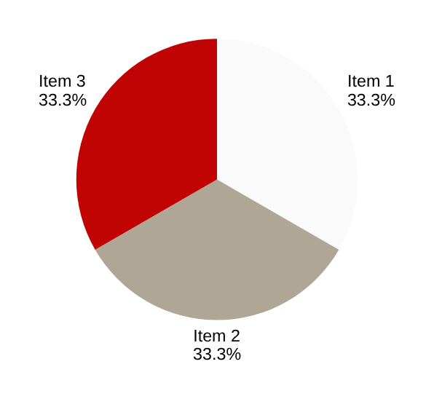
SIZE OF MARKET
Understanding the market size is important for us. In the US, there are about 32 million small businesses. We're aiming at industries like technology, e-commerce, and professional services, which are about 30% of all small businesses. That means we're looking at around 9.6 million potential customers. Our goal is to get about 5% of them, which would be roughly 480,000 businesses. This helps us know who to target and plan our growth strategy.
Total Addressable Market
(TAM):
32 million
Serviceable Addressable Market (SAM):
9.6 million
Serviceable Obtainable Market (SOM):
480,000

Slide 9
DIRECT COMPETITOR:
INDIRECT COMPETITOR:
Offers similar services or products to ours.
Provides different services or products that solve similar customer needs or problems.
Targets the same customer base and market segments.
Targets overlapping or adjacent market segments but may not directly compete with us.
Competes directly with us in terms of pricing, features, and positioning.
Might offer complementary products or services that could substitute or supplement ours.
Can be easily identified and recognized as a competitor by customers and industry analysts.
Can include companies from different industries or sectors that indirectly impact our market.

Slide 10
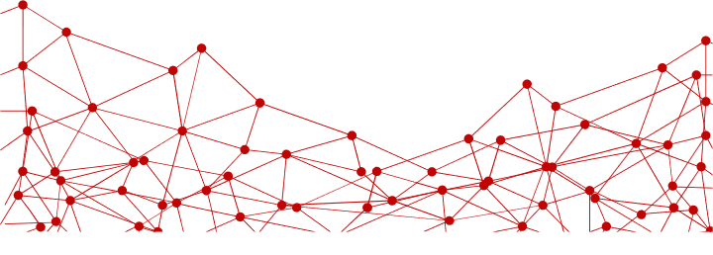
KEY COMPETITIVE ADVANTAGES
Expert Team
Customer Focus
Our skilled team brings specialized knowledge and experience to provide top-notch solutions tailored to our clients' needs.
We prioritize building strong relationships and understanding our clients' needs, leading to long-term partnerships based on trust and satisfaction.
Cutting-Edge Technology
Proven Success
We use the latest tools and technology to stay ahead, ensuring efficient and effective services.
With a track record of successful projects, we've earned a reputation for reliability and excellence, setting us apart from the competition.

Slide 11
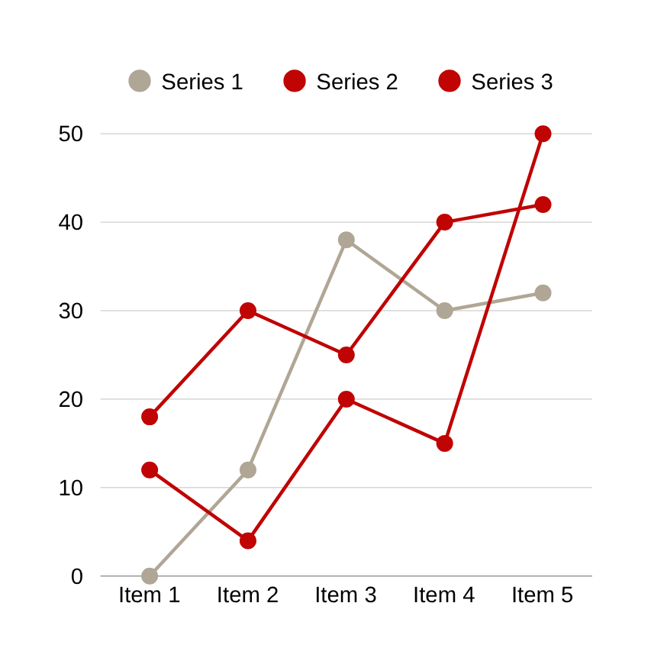

TRACTION
This matrix provides a snapshot of various success metrics for our company, including revenue growth, customer satisfaction, market share, employee retention, innovation, and brand reputation.
20%
Annual revenue growth
90%
Maintain customer satisfaction ratings
15%
Market share in key segments

Slide 12
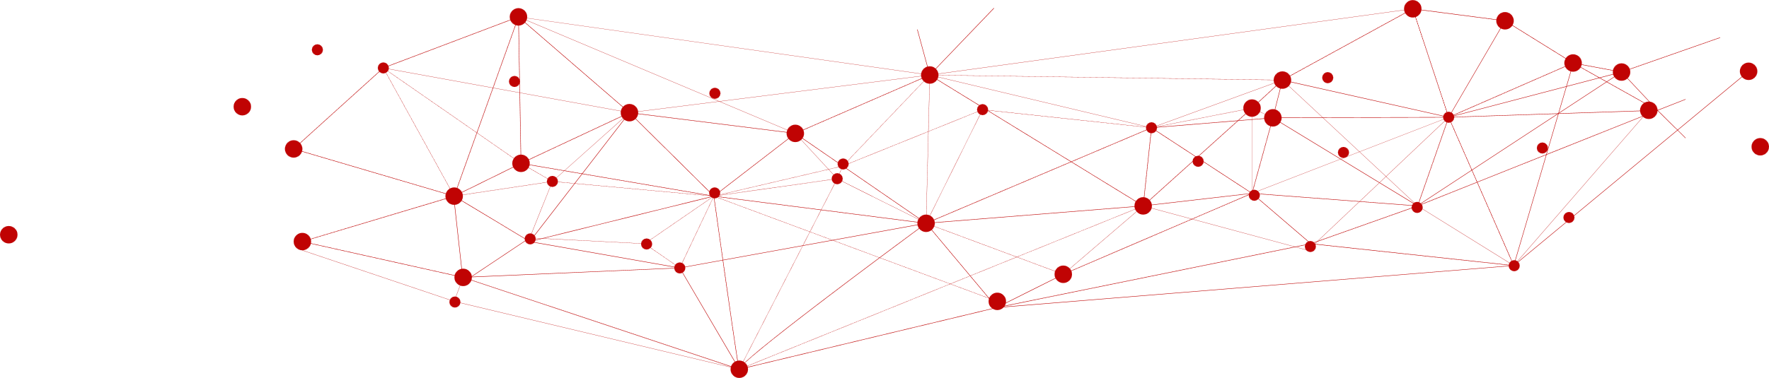
REVENUE MODEL
 | BASIC PLAN | STANDARD PLAN | PREMIUM PLAN
PRICING: | 135$/ month | 175$/ month | 220$/ month
FEATURES: | Limited features Basic support No customization | More features Standard support Some customization | Full features Priority support Full customization
USAGE LIMITS: | Limited usage Limited storage | Increased usage More storage | Unlimited usage Unlimited storage
ADDITIONAL SERVICES: | No additional services included | Optional add-ons available for purchase | Premium support and consulting included

Slide 13
ACCOMPLISHMENTS DATE
2021
2023
2025
Present
In our first year, we successfully launched a new product/service, received positive feedback from early users, and formed partnerships with key industry players.
We expanded into new markets, improved operational efficiency, and saw an increase in customer satisfaction.
We secured funding for growth, refined our offerings based on customer feedback, and formed strategic partnerships.
In our first year, we successfully launched a new product/service, received positive feedback from early users, and formed partnerships with key industry players.

Slide 14
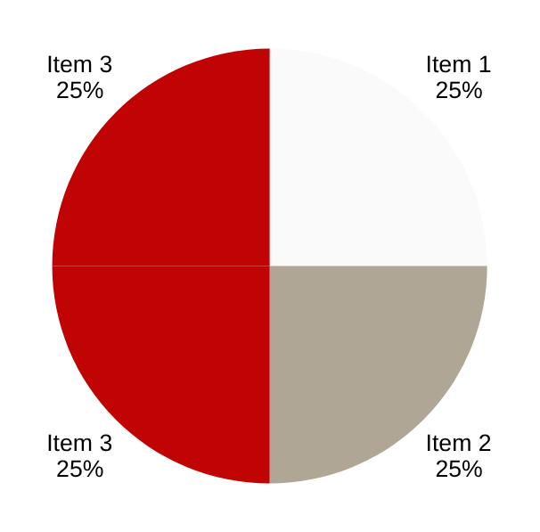
USE OF FUNDS
Our plan for using funds generated from investors is straightforward. We'll allocate 40% towards further developing our products, ensuring they stay competitive and meet customer needs. 30% will go into marketing and sales efforts to attract new customers and drive revenue growth. 20% will be invested in infrastructure and operations to support our expanding business and improve efficiency. Finally, 10% will be set aside for strategic initiatives like market expansion and partnerships to fuel long-term growth.
Product Development
40%
Marketing and Sales
30%
Infrastructure and Operations
20%
Expansion and Growth Initiatives
10%

Slide 15

Ingoude Company
THANK YOU
FOR YOUR TIME AND ATTENTION
Present by Neil Tran
www.reallygreatsite.com
hello@reallygreatsite.com
123 Anywhere Street., Any City

